Slide 1

EE3L11 Bachelor Graduation project
Workshop 1
Delft Centre for Entrepreneurship
www.tudelft.nl/dce

Slide 2
Workshop 1
What is the name of your product / idea ^{(*)}
What problem do you address (size and urgency) and what is the solution?
Who is your main users/ customer/ beneficiary?
Provide insight into, empathy with the work they do and problems they have
What is the use-case?
What are existing solutions for the user
What can the user do better now
How valuable is that for the user
How does the solution fit the work environment of the user, the job they do?

Slide 3
Workshop 2
How many users do possibly exist, how many user groups
What will be your communication plan,
What is your narrative, what channels will you use?
How do they know about your solution?
What is needed to bring the solution to a useable state for users?
How long will it take
What resources are needed
With whom do you need to work?

Slide 4
Course Assessment
Two meetings, two team assignments:
Workshop assignment #1
Workshop assignment #2
2 page synopsis: investment plan summary
Fail or pass

Slide 5
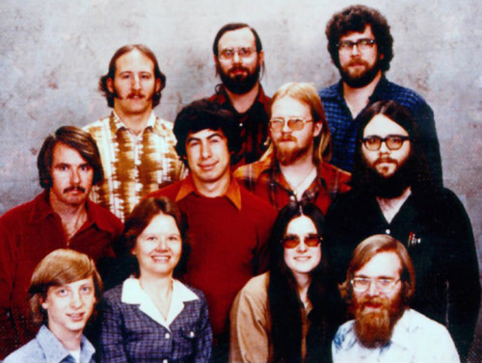
Gates read the January 1975 issue of Popular Electronics which demonstrated the Altair 8800, and contacted Micro Instrumentation and Telemetry Systems (MITS) to inform them that he and others were working on a BASIC interpreter for the platform.
In reality, Gates and Allen did not have an Altair and had not written code for it; they merely wanted to gauge MITS's interest.
MITS president Ed Roberts agreed to meet them for a demonstration, and over the course of a few weeks they developed an Altair emulator that ran on a minicomputer, and then the BASIC interpreter.
➔ What does this tell us?

Slide 6
Why a business Plan
"The business plan is a necessity. If the person who wants to start a small business can't put a business plan together, he or she is in trouble," says Robert Krummer, Jr., chairman of First Business Bank in Los Angeles.
Do you construct a house without a blueprint ?
Before you begin writing your business plan, consider four core questions:
What problem can your technology solve
Who are the potential customers for your product or service and why will they purchase it from you?
What service or product can be offered, what needs does it fill?
How will you reach your potential customers?
Where will you get the financial resources to start your business?
For BAP, it is an exercise to make impact with your technology
And it will be fun

Slide 7
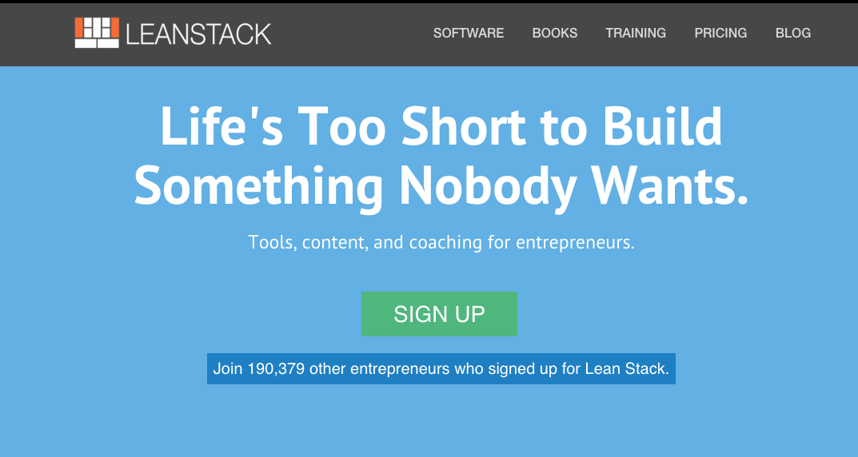
Starting point
Create Canvas
Using lean canvas
Goal is to think about the key questions of your business model
Not only your product
Use a template to
follow progress

Slide 8
Assessing business ideas
Do users/customers want this? Is the idea needed or wanted? Does it resolve problems? Does the intended audience see its value?
Desirability
Viability
Feasibility
Can we do this? Do we have the knowhow, skills, resources and technology to deliver? How realistically can we make it happen?
Should we do this? Is it economically or commercially beneficial? Is the business model (financially) sustainable?

Slide 9
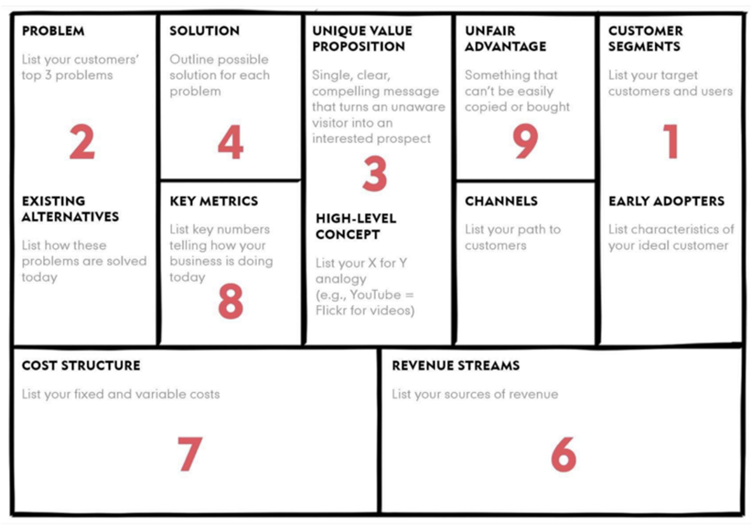
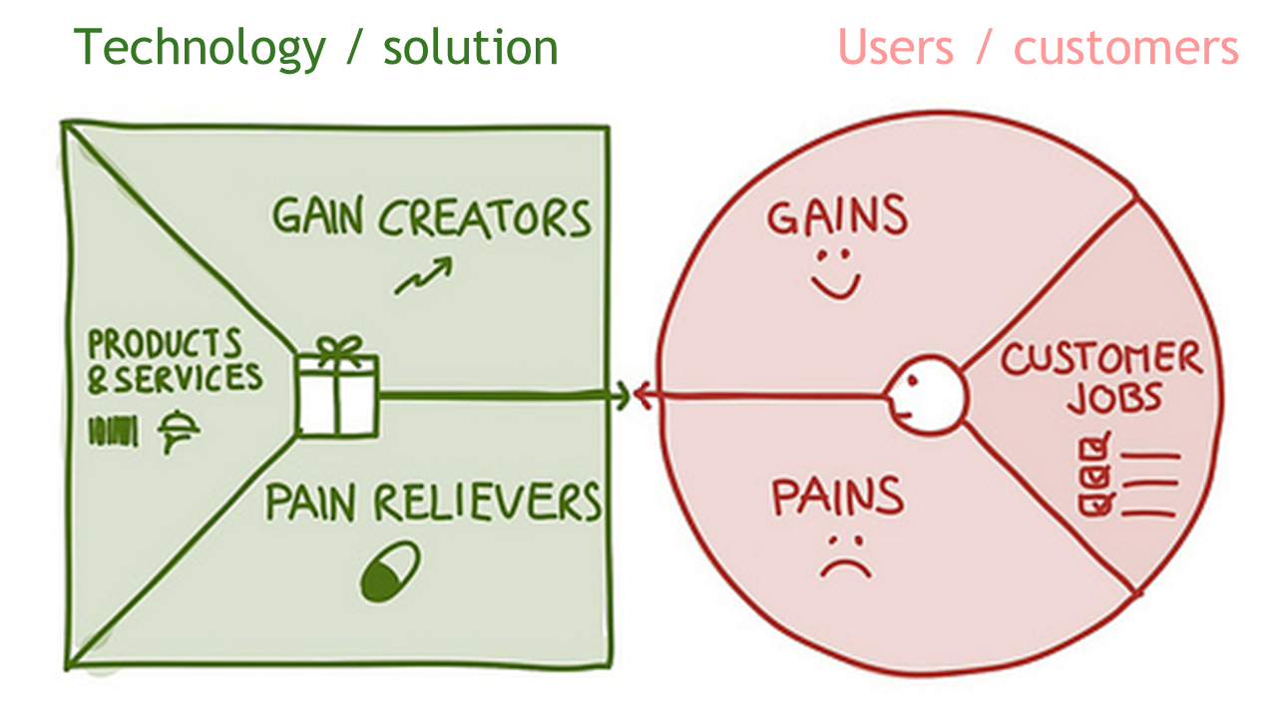
Desirability
Assignment 1 – Value Proposition
Lean Canvas
Desirability
Value Proposition Canvas

Slide 10
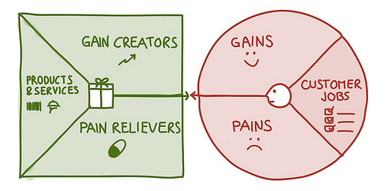
Value Proposition Canvas
Assignment 1 – Value Proposition
Technology / solution
Users / customers

Slide 11
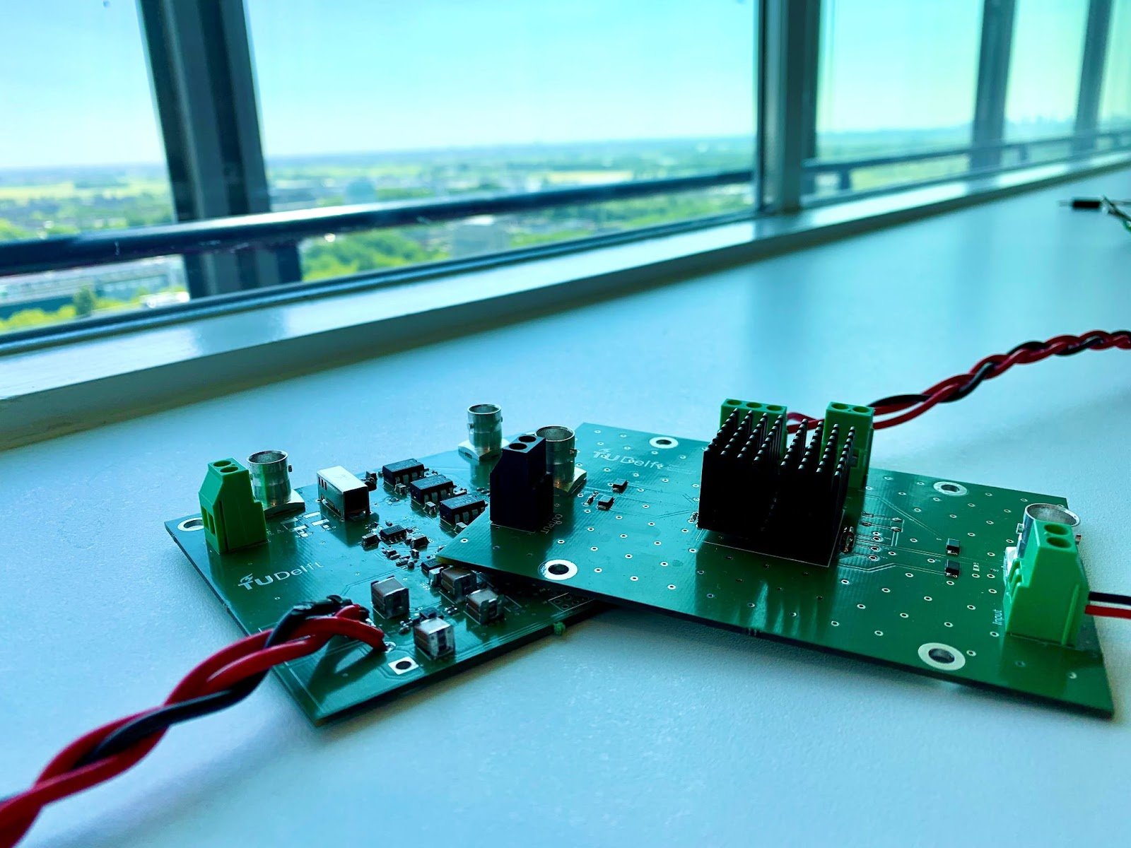
Feasibility
Assignment 2 – Design and market the solution
Product and poster for Grand Finale
Feasibility
Breakdown and assessment of all processes and resources necessary to create, market, sell, deliver the product

Slide 12
Breakdown and assessment
Development process
Production process
Service process
Customer acquisition processes (marketing, sales)
Legal
Financial
Human Resources
………….
Office space
Manufacturing space
Utilities
Insurance
Storage facilities
Transport facilities
Partners/suppliers
………….
What do we need to make it happen?
Can we make it happen, is it feasible?

Slide 13
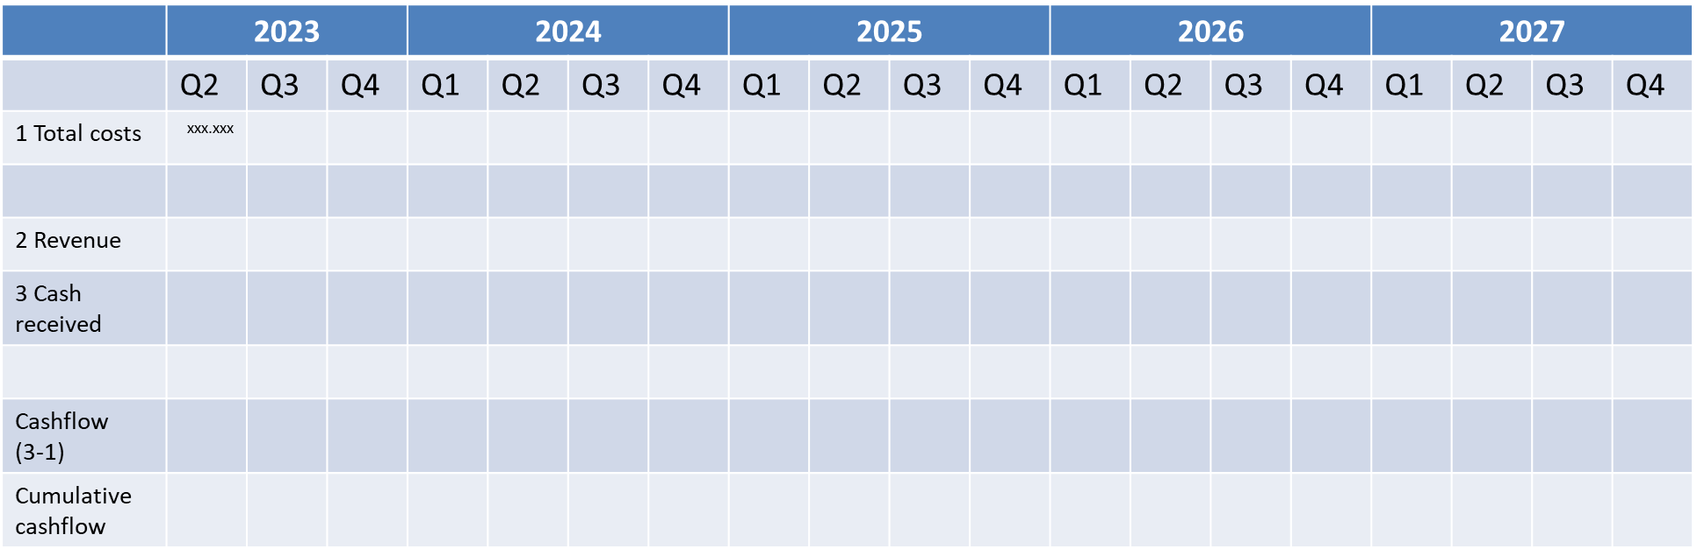
Viability
Assignment 3 – Business model, Revenue model & Financials
Lean Canvas
Viability
Cash flow analysis

Slide 14

Opportunities for your technology
1. sensing or perceiving market needs and/ or under employed resources
identifying an information asymmetry
2. recognizing a fit between needs and resources
closing the information asymmetry
3. creating a fit through a business concept
exploiting the opportunity
➔ Start describing your technology as ‘We know how to…’

Slide 15
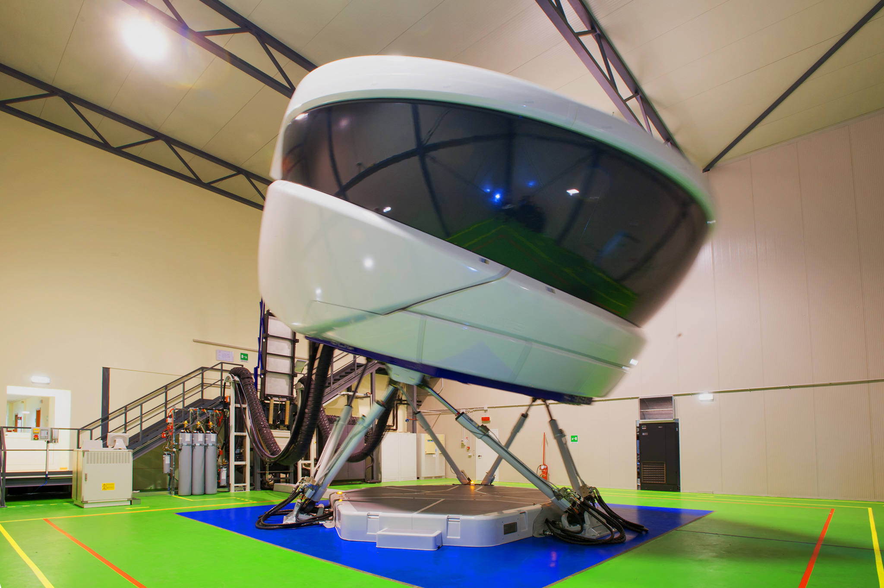
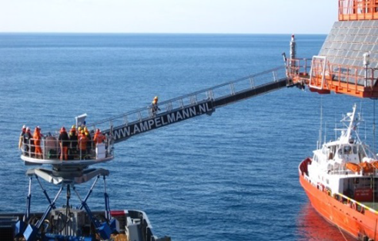
Examples
We know how to
simulate motion
compensate unwanted motion

Slide 16
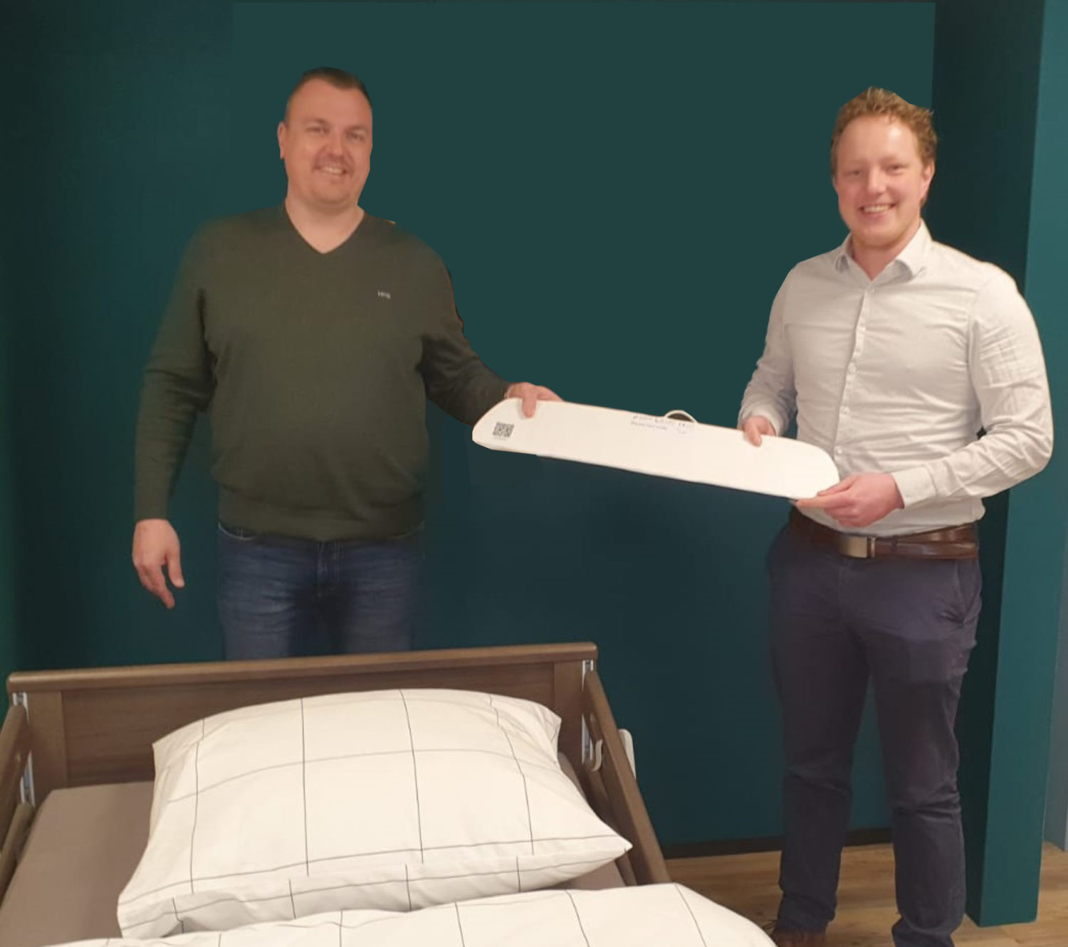
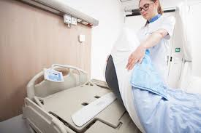
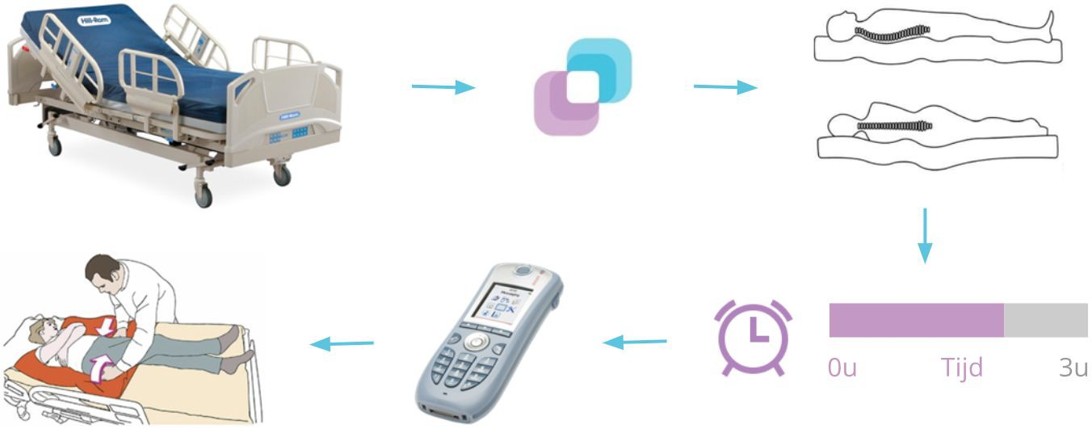

Examples
We know how to
measure pressure/ (using pressure sensors)
weight distribution
predict development of pressure wounds

Slide 17
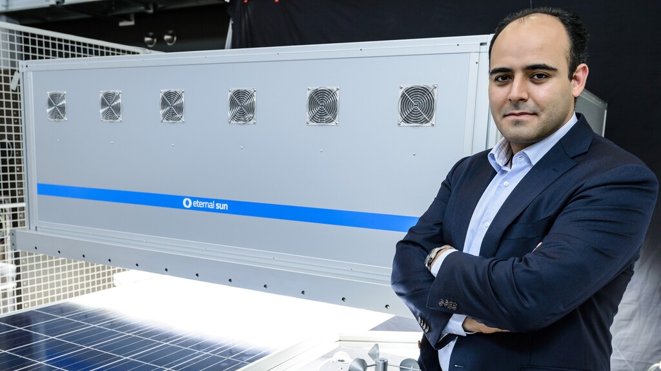
Examples
We know how to
simulate the sun
Test the quality of solar panels
But which market???
 | market
Panel producers | 1000
Commercial test providers | 650
Public R & D test providers | 300
University research equipment | 50

Slide 18
Lean Canvas
Project Name
Problem
Top 3 problems
Solution
Top 3 features
Unique Value Proposition
Single, clear, compelling message that states why you are different and worth paying attention
Unfair Advantage
Can’t be easily copied or bought
Customer Segments
Target customers
Key Metrics
Key activities you measure
Channels
Path to customers
Cost Structure
Customer Acquisition costs
Distribution costs
Hosting
People, etc.
Revenue Streams
Revenue Model
Life Time Value
Revenue
Gross Margin
PRODUCT
MARKET

Slide 19
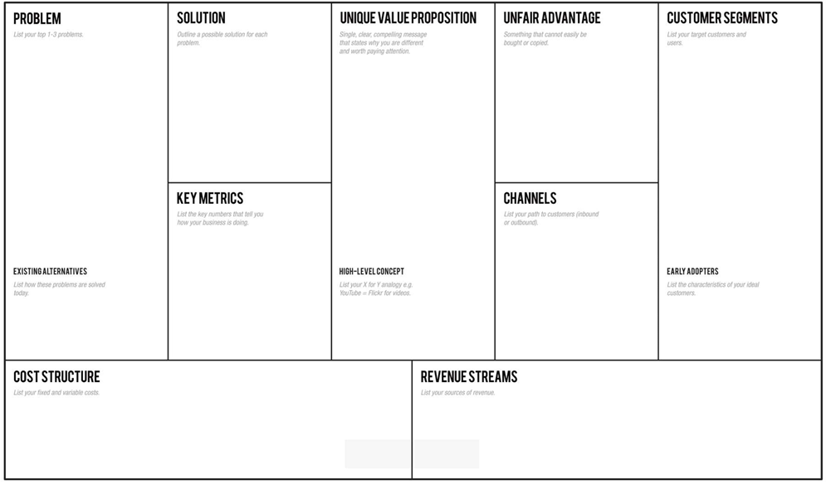
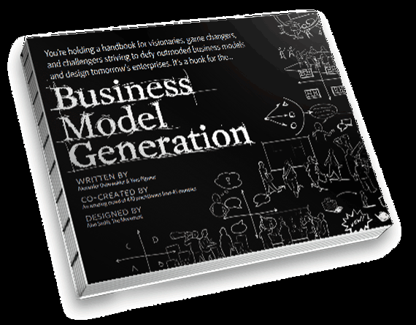
Value Proposition Canvas

Slide 20
Value Proposition Canvas
Technology / solution
Users / customers

Slide 21
Value Proposition Canvas
Develop a fit between the offer you have and the customer needs
https://youtu.be/jUsrkasOBVk
Further Info:
Download
http://designabetterbusiness.com/2017/10/12/how-to-really-understand-your-customer-with-the-value-proposition-canvas/
https://strategyzer.com/canvas/value-proposition-canvas

Slide 22
Value Proposition Canvas
Your technology, is a solution in need of a problem
My technology what can it do, and could not be done before…
Why would this be interesting and when would this be interesting for users?
Market: How big is the problem, how many people are affected? Are they willing to pay?
Formulate hypotheses about the value proposition.
What can and should technology do?
What problems can it solve?
Who has such a problem, which users and are they willing to purchase?

Slide 23
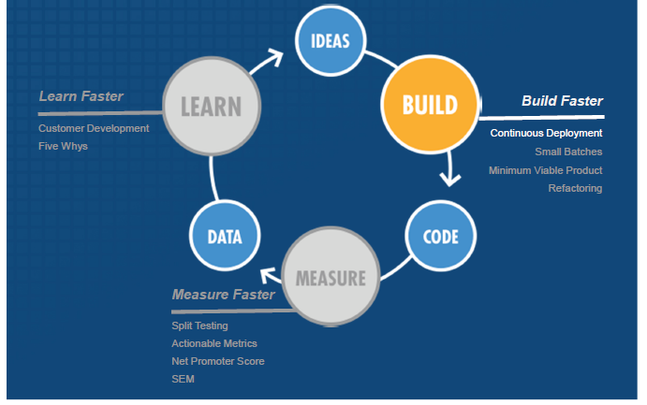
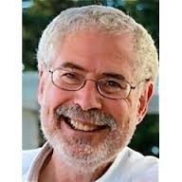
Approach: Build-Measure-Learn
Value Proposition Canvas
Learn
Evaluate hypotheses
Adapt your idea
Articulate hypotheses
Product feature
User group specs
User group size
Measure
Bring in evidence
Talk to people

Slide 24
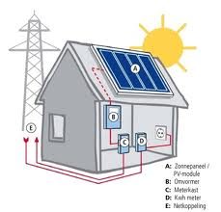


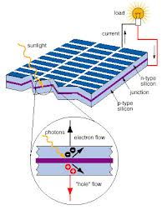
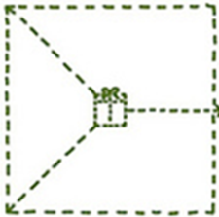


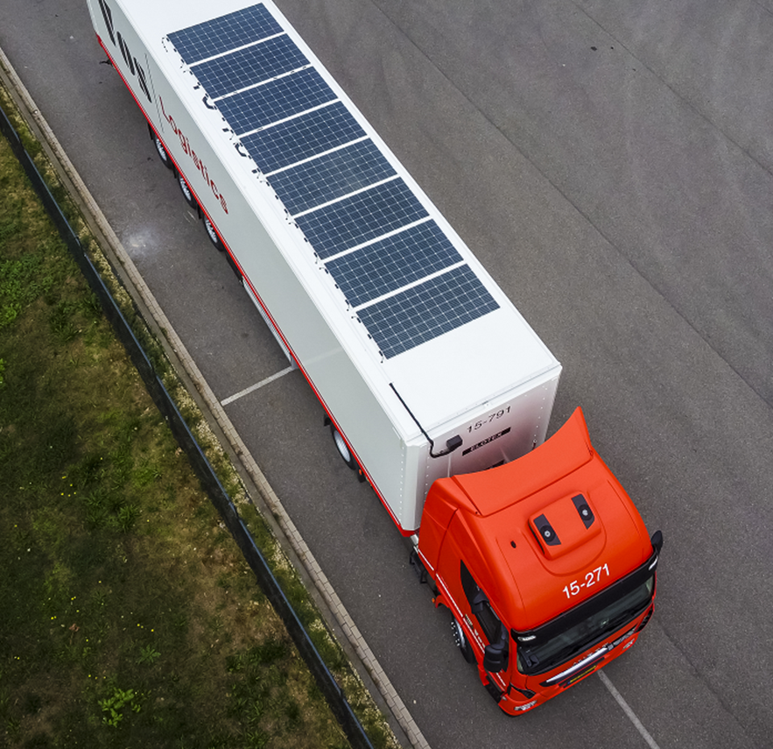

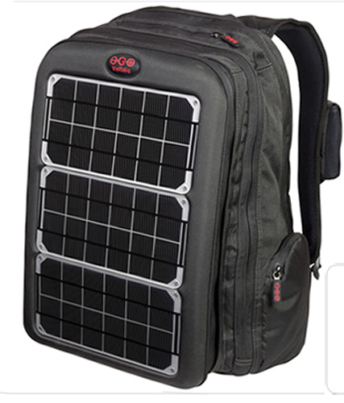
More than 1 customer segment
Hypotheses Our solar panels are more efficient than existing Our solar panels are robust Households/ transport/ travellers (markets) do have a need The problem they have… The size of the market Can they afford it? Competition? Can we do it?
Value Proposition Canvas

Slide 25
Targeting and Market Segmentation
Try to be specific who your user might be
The process of dividing the total market for a good or service into smaller groups, each of which tends to be homogenous (or similar) in all significant aspects.
One or more of these segments is then selected as the firm’s target market/s.

Slide 26

Market Segmentation Process
Identify the needs and wants of customers.
Identify the different characteristics between market segments.
Estimate the market potential.

Slide 27
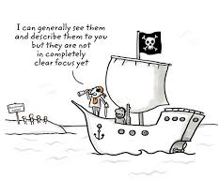
Beachhead market
Effective segmentation
Your first entry to the market
Small enough to be a significant player
Big enough to generate cash and grow in related markets
Opportunity to extent to other markets

Slide 28
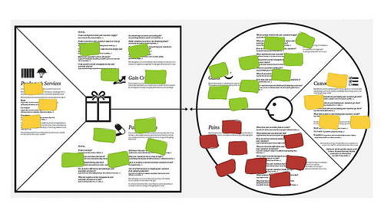
Value Proposition Canvas

Slide 29
Value Proposition Canvas
Technology
What does the technology do?
What alternatives are available?
What gains does you technology offer?
Or what pains does it solves
Latent problems/ taken for granted

Slide 30
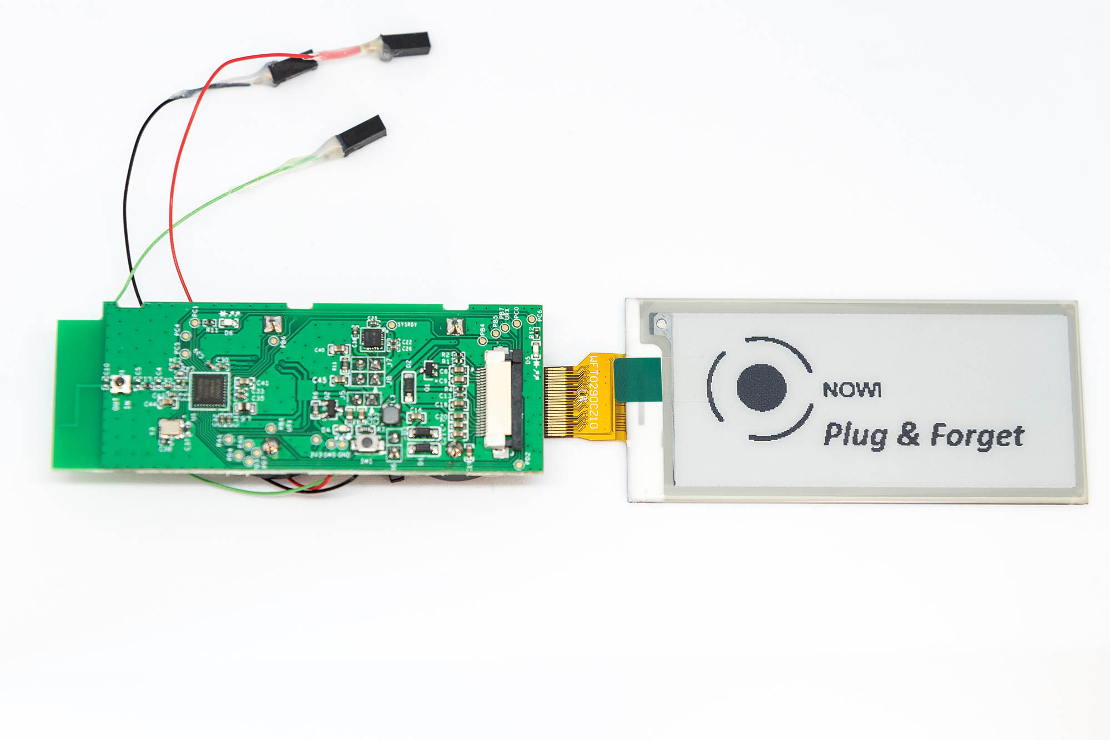
Mapping problems that can be targeted
Value Proposition Canvas
power management integrated circuits (PMICs) for low power energy harvesting
My technology has specific benefits
Small / flexible
No wiring/ no battery
Enabling technology
But also some limitations
Small capacity
Evidence, not fully proven
https://www.youtube.com/watch?v=jUsrkasOBVk&feature=youtu.be

Slide 31

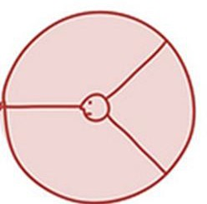

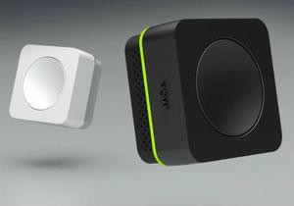
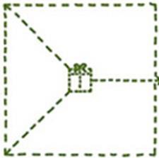


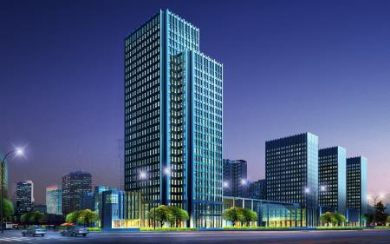

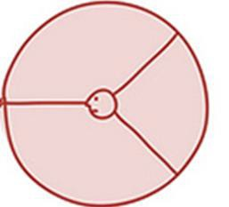
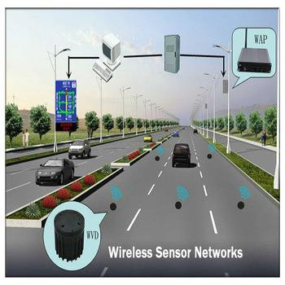

Value Proposition Canvas
More than 1 segment
Smoke alarm
Climate control
Traffic monitoring

Slide 32
Value Proposition Canvas
Users / customers
How do people solve the problem currently?
How do they do their job?
Does your offer fit in their job?
Does your offer solve the problem better than the current solution?
People hire products/ services to do a job for them
➔ Do not provide the solution before you validate the problem exists

Slide 33
Value Proposition Canvas
Customer Job
People hire products/ services to do a job for them
Christensen: https://www.youtube.com/watch?v=sfGtw2C95Ms
Gains:
We can do the job fast, easier, more accurate…
= can be interesting if exceeds the cost of change (switching cost)
Pains:
We can do a job in a way we could not do before
= more urgent, a need to have
Analyse the customer business case!!
Users / customers

Slide 34
Customer discovery
Develop questions, your assumptions and translate them into hypotheses
Identify possible user applications
Hypothesis:
The PMIC can be used to power a smoke alarm/ climate control/ measure traffic
For smoke control, the market is large enough
The benefit of PMIC in smoke alarms, is you do not need to change batteries
Facility management at Schiphol can save money with the PMC
Facility management is interested in purchasing the OMC-based smoke alarm
Watering holes?
➔ Analyse the jobs they try to get done and validate it works

Slide 35
Key questions for the market
Characteristics
Does the target customer have a compelling reason to buy?
Do they have a pain that needs to be solved, something they could not do before
Or do they have a gain when using the technology: it is faster, cheaper, more accurate and it will save money for the customer that outweighs the switching cost
This addresses the sense of urgency. The alternatives the customer currently has are performing far worse than the offer that the participant presents and in addition the participant has shown some basic understanding of the customer business case. Gives details on how the customer can have returns in term of money, time, increased quality of the offer, that justifies the purchase of the offer.
Is the target customer well-funded?
Is the customers willing to pay and can afford the product/ service offer
Is the target customer easily accessible, you can connect to them?
how to address the customer segment? How can you talk to them and how do they know about the product and to make sure that a product sale can actually happen
Is there entrenched competition that could block you?
What alternative do customers have and will competition react?
If you win this segment, can you leverage it to enter additional segments?
Can you scale to other markets to grow?
Draw up a list of at max. 5 potential markets that have users that would use your technology
 | User group 1 | User group 2 | User group 3 | User group 4 | User group 5
Characteristic 1 | Low- high, or Easy-difficult, etc.
Characteristic 2
Characteristic n
TOTAL

Slide 36
As an Entrepreneur, you have:
Limited amount of:
Money,
Time
Human capital

Slide 37
As an Entrepreneur, you have:
Limited amount of:
Money,
Time
Human capital
So how do you start?
Beachhead market?

Slide 38
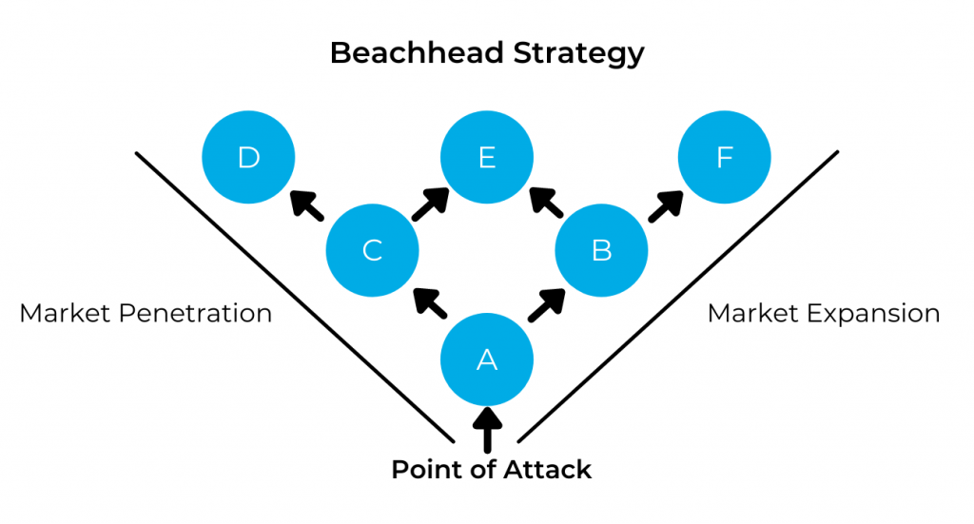
Beachhead market:
“A beachhead market is the place where, once you gain a dominant market share, you will have the strength to attack adjacent markets with different opportunities, building a larger company with each new following,”

Slide 39
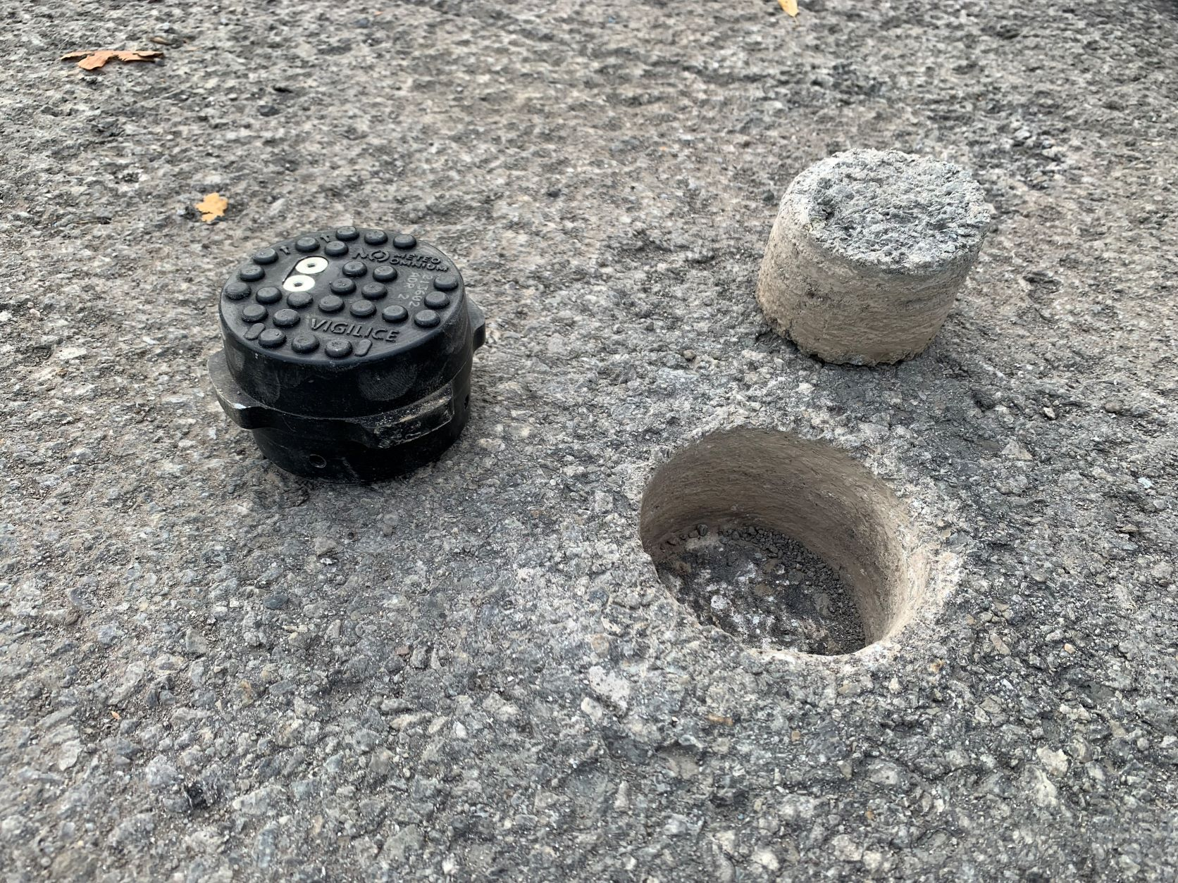
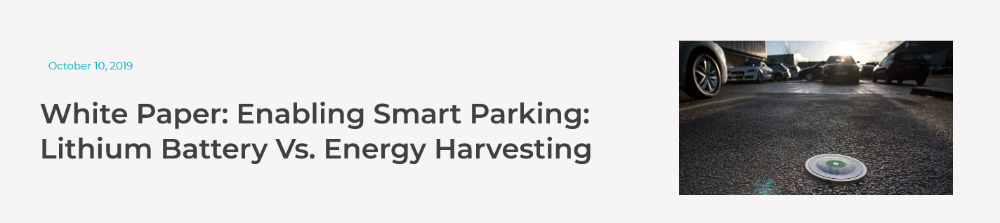
Your Beachhead Market:
Nowi: why they chose road monitoring to warn for icing in Amsterdam?
Not the biggest market (mostly)!
Easiest for you (as entrepreneurial company) to capture
Big enough such that:
Brings enough cash flow,
Builds up enough critical mass
Strategic, brings access to other markets
Offers possibility to learn, get feedback, co-create

Slide 40


Market opportunities
The development process to come from tech-idea to opportunity
Identify opportunities
Opportunity discovery and evaluation
Opportunity exploitation
Importance of experiential learning
Learning and reflection on doing (Kolb, 1984)
Adapt existing knowledge to user applications
Iterative learning, forward and backward adjustments

Slide 41
Last points
Evidence is key
Customer discovery
Lean approach to develop your idea
Be engaged and work as a smart team
Divide tasks but all are responsible
Don’t wait for a response. Act, Act, Act
Good luck

